Slide 1


CMR TECHNICAL CAMPUS
UGC AUTONOMOUS
(Accredited by NAAC, NBA, Permanently Affiliated to JNTUH, Approved by AICTE, New Delhi) Recognized - Under Section 2(f) & 12(B) of the UGC Act.1956
DEPARTMENT OF COMPUTER SCIENCE ANDENGINEERING
MINI PROJECT
ON
COMPARATIVE STUDY OF MACHINE LEARNING ALGORITHMS FOR
FRAUD DETECTION IN BLOCKCHAIN
Under the Guidance of
Dr. Jonnadula Narasimharao (Associate Professor)
Presented By (BATCH NO : 23)
K Suryabhaskar (207R1A0522)
K Yashmine (207R1A0523)

Slide 2
Table of contents :
Abstract
Existing System
Disadvantages of Existing System
Proposed System
Advantages of Proposed System
Hardware Requirements
Software Requirements
Novelty
Architecture
Modules
UML Diagrams
Sample Code
Results
Conclusion
Future Scope
References
Github Link

Slide 3
ABSTRACT :
Fraudulent transactions have a huge impact on the economy and trust of a blockchain network. Consensus algorithms like proof of work or proof of stake can verify the validity of the transaction but not the nature of the users involved in the transactions or those who verify the transactions which it still vulnerable to fraudulent activities.
One of the best ways to eliminate fraud is by using Machine Learning techniques. Machine learning can be of supervised or unsupervised nature. Here, we use various supervised machine learning techniques to check for fraudulent and legitimate transactions. We also provide an extensive comparative study of various supervised machine learning techniques like decision trees, Naive Bayes, logistic regression, multilayer perceptron, and so on.

Slide 4
EXISTING SYSTEM:
Fraudulent transactions are harmful to the economy and discourage people from investing in bitcoins or even trusting other blockchain-based solutions. Fraudulent transactions are usually suspicious either in terms of participants involved in the transaction or the nature of the transaction.
Members of a blockchain network want to detect Fraudulent transactions as soon as possible to prevent them from harming the blockchain network’s community, integrity and also secure tracking and storage of transaction details was not completely secure as the user is not verified from the right perspective.

Slide 5
DISADVANTAGES :
Lack of regulation
Difficulty in tracing transactions
Limited data availability
False positives
Limited ability to detect complex fraud

Slide 6
PROPOSED SYSTEM:
The proposed system model consists of two major blocks : Blockchain and Machine Learning. The blockchain model initiates transactions, and then machine learning models are used to classify these transactions as malicious or legitimate. The proposed system model is based on the integration of machine learning and blockchain for fraud and anomaly detection in the financial sector.
This anomaly detection system identifies unusual suspicious events that are different from most of the data. We also use the random forest and XGboost (Extreme Gradient boosting) classifiers to classify legitimate and malicious transactions. These classifiers are also used to predict new incoming transactions. The proposed model is trained and tested for legitimate and malicious data patterns using the given dataset.

Slide 7
ADVANTAGES :
Improved Accuracy
Reduces False Positives
Cost-effective
Scalability
Flexibility

Slide 8
HARDWARE REQUIREMENTS :
CPU : Processors above i3.
RAM : Minimum 4GB or above.
Storage : 256 SSD

Slide 9
SOFTWARE REQUIREMENTS:
Operating System : Windows 8 or above
Coding Language : Python
Tool / IDE : Jupyter Notebook, PyCharm, Visual Studio Code

Slide 10
Novelty :
It mainly plays major role in Bitcoin transactions and many international small scale to large scale transactions. Machine Learning algorithms play major role in detecting fraud transaction and while accessing data in the blockchain ledger.
The accuracy of this project increases as the training of the algorithms increases and yields more accurate detection.

Slide 11
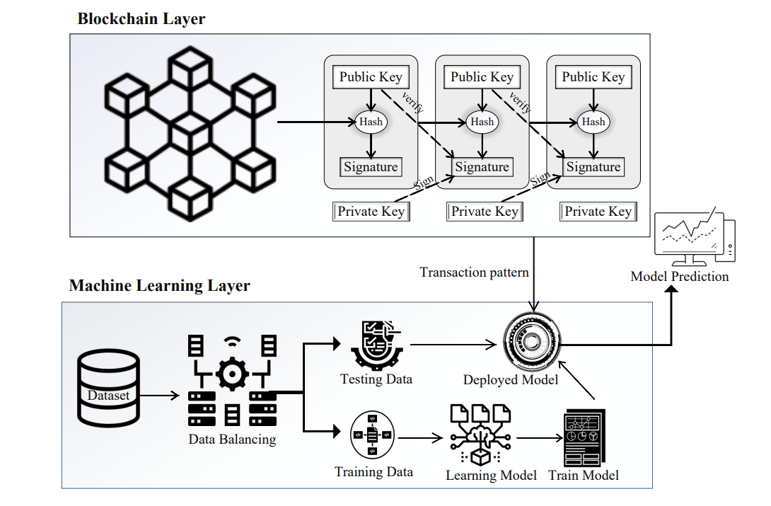
ARCHITECTURE :

Slide 12
MODULES :
Upload & Preprocess Dataset
Generate Train & Test Model
Comparison Graph
Predict Fraud

Slide 13
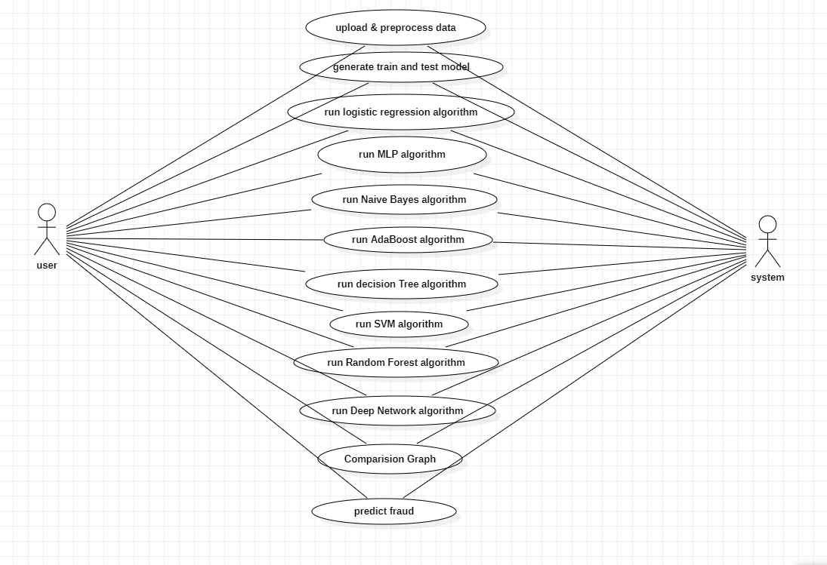
UML DIAGRAMS :
USE CASE DIAGRAM :

Slide 14
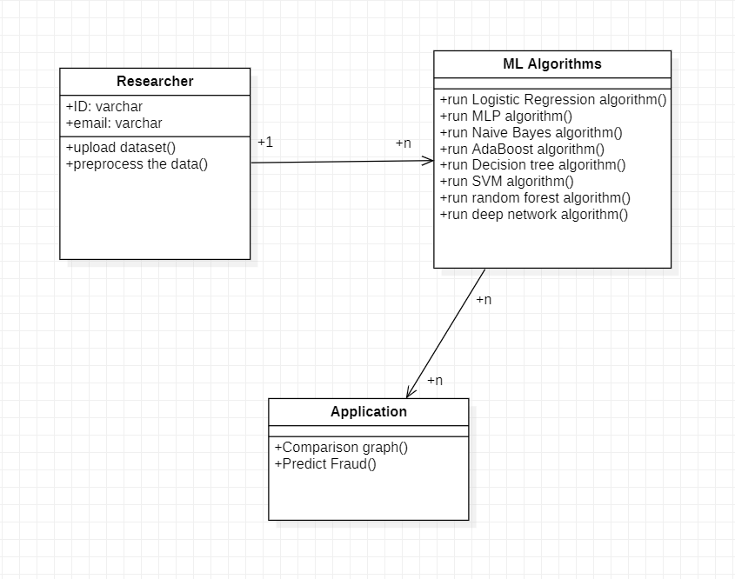
CLASS DIAGRAM :

Slide 15
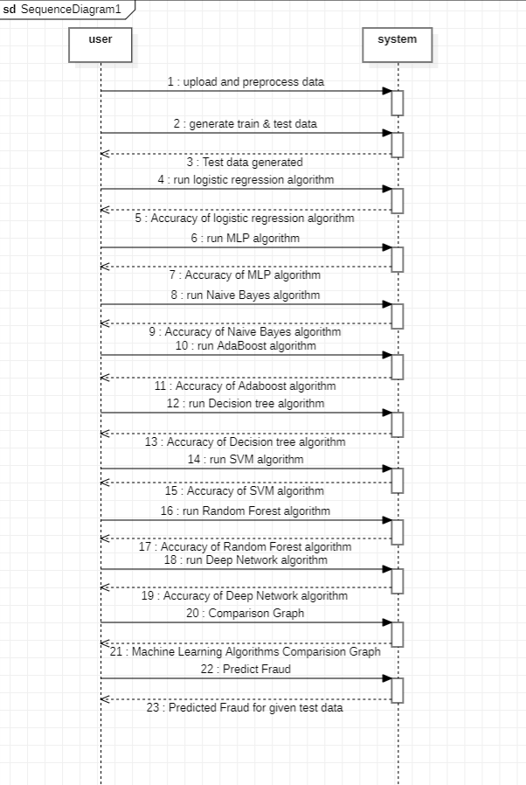
SEQUENCE DIAGRAM :

Slide 16
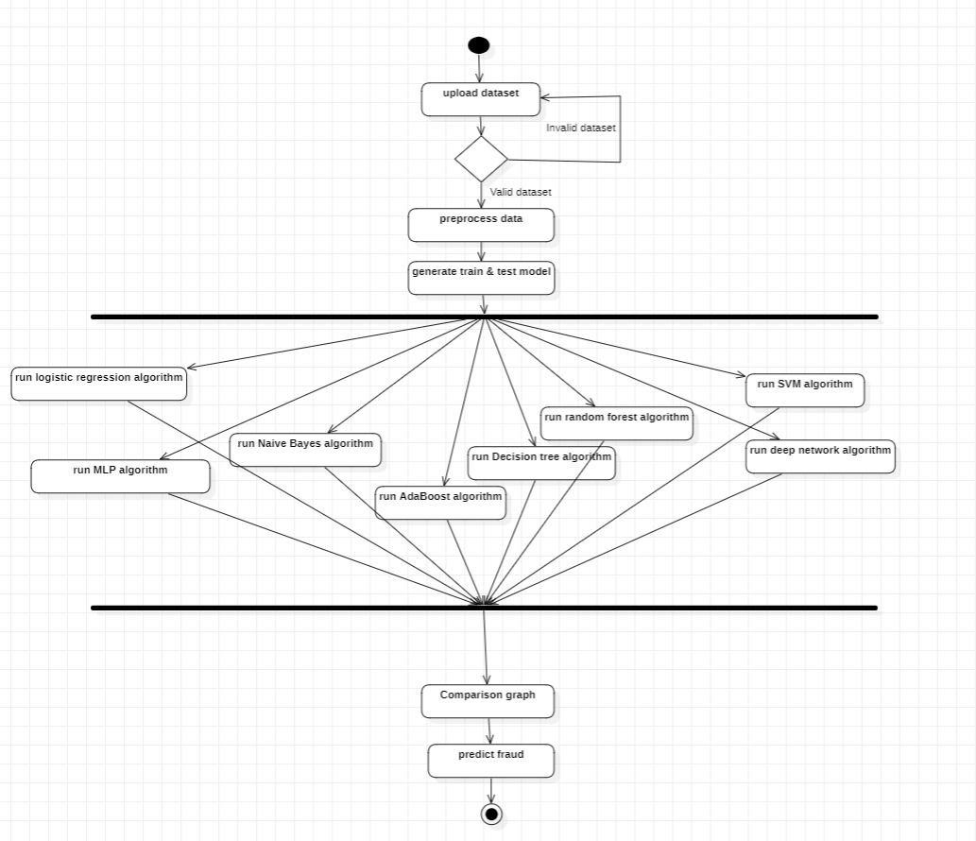
ACTIVITY DIAGRAM :

Slide 17
Sample Code :
global filename
global X,Y
global dataset
global main
global text
accuracy = []
precision = []
recall = []
fscore = []
global X_train, X_test, y_train, y_test, predict_cls
global classifier
main = tkinter.Tk()

Slide 18
def uploadDataset():
global filename
global dataset
text.delete('1.0', END)
filename = filedialog.askopenfilename(initialdir="Dataset")
text.insert(END,filename+" loaded\n\n")
dataset = pd.read_csv(filename)
text.insert(END,"Dataset before preprocessing\n\n")
text.insert(END,str(dataset.head()))
text.update_idletasks()
label = dataset.groupby('FLAG').size()
label.plot(kind="bar")
plt.title("Blockchain Fraud Detection Graph 0 means Normal & 1 means Fraud")
plt.show()

Slide 19
def calculateMetrics(algorithm, predict, y_test):
a = accuracy_score(y_test,predict)*100
p = precision_score(y_test, predict,average='macro') * 100
r = recall_score(y_test, predict,average='macro') * 100
f = f1_score(y_test, predict,average='macro') * 100
accuracy.append(a)
precision.append(p)
recall.append(r)
fscore.append(f)
text.insert(END,algorithm+" Accuracy : "+str(a)+"\n")
text.insert(END,algorithm+" Precision : "+str(p)+"\n")
text.insert(END,algorithm+" Recall : "+str(r)+"\n")
text.insert(END,algorithm+" FScore : "+str(f)+"\n\n")

Slide 20
def runMLP():
mlp = MLPClassifier()
mlp.fit(X_train, y_train)
predict = mlp.predict(X_test)
calculateMetrics("MLP", predict, y_test)
def runNaiveBayes():
cls = GaussianNB()
cls.fit(X_train, y_train)
predict = cls.predict(X_test)
calculateMetrics("Naive Bayes", predict, y_test)
def runAdaBoost():
cls = AdaBoostClassifier()
cls.fit(X_train, y_train)
predict = cls.predict(X_test)
calculateMetrics("AdaBoost", predict, y_test)

Slide 21
def runSVM():
cls = svm.SVC()
cls.fit(X_train, y_train)
predict = cls.predict(X_test)
calculateMetrics("SVM", predict, y_test)
def runRF():
global predict_cls
rf = RandomForestClassifier()
rf.fit(X_train, y_train)
predict = rf.predict(X_test)
predict_cls = rf
calculateMetrics("Random Forest", predict, y_test)
def runDT():
global predict_cls
cls = DecisionTreeClassifier()

Slide 22
cls.fit(X_train, y_train)
predict = cls.predict(X_test)
calculateMetrics("Decision Tree", predict, y_test)
uploadButton = Button(main, text="Upload & Preprocess Dataset", command=uploadDataset)
uploadButton.place(x=50,y=550)
uploadButton.config(font=font1)
traintestButton = Button(main, text="Generate Train & Test Model", command=trainTest)
traintestButton.place(x=330,y=550)
traintestButton.config(font=font1)
lrButton = Button(main, text="Run Logistic Regression Algorithm", command=runLogisticRegression)
lrButton.place(x=630,y=550)
lrButton.config(font=font1)
mlpButton = Button(main, text="Run MLP Algorithm", command=runMLP)
mlpButton.place(x=950,y=550)
mlpButton.config(font=font1)

Slide 23
nbButton = Button(main, text="Run Naive Bayes Algorithm", command=runNaiveBayes)
nbButton.place(x=50,y=600)
nbButton.config(font=font1)
adaboostButton = Button(main, text="Run AdaBoost Algorithm", command=runAdaBoost)
adaboostButton.place(x=330,y=600)
adaboostButton.config(font=font1)
dtButton = Button(main, text="Run Decision Tree Algorithm", command=runDT)
dtButton.place(x=630,y=600)
dtButton.config(font=font1)
svmButton = Button(main, text="Run SVM Algorithm", command=runSVM)
svmButton.place(x=950,y=600)
svmButton.config(font=font1)
rfButton = Button(main, text="Run Random Forest Algorithm", command=runRF)
rfButton.place(x=50,y=650)
rfButton.config(font=font1)

Slide 24
dnButton = Button(main, text="Run Deep Network Algorithm", command=runDeepNetwork)
dnButton.place(x=330,y=650)
dnButton.config(font=font1)
graphButton = Button(main, text="Comparison Graph", command=graph)
graphButton.place(x=630,y=650)
graphButton.config(font=font1)
predictButton = Button(main, text="Predict Fraud ", command=predict)
predictButton.place(x=950,y=650)
predictButton.config(font=font1)
main.config(bg='LightSkyBlue')
main.mainloop()

Slide 25
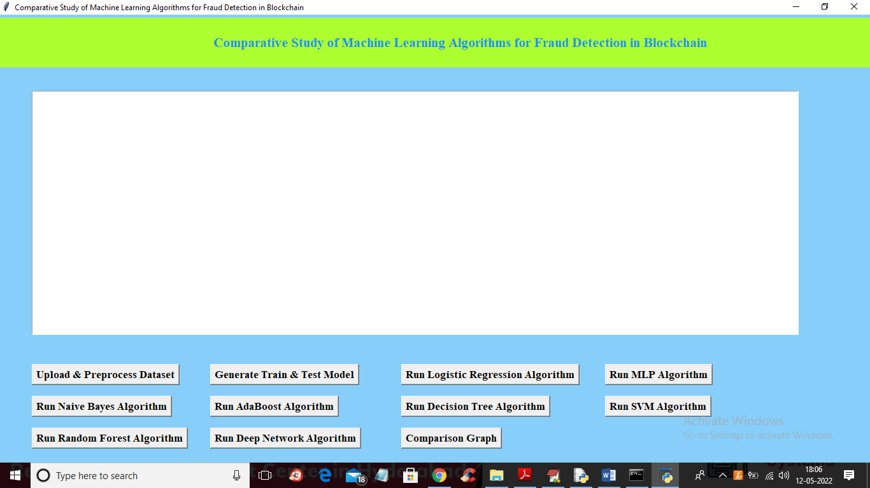
Results :

Slide 26
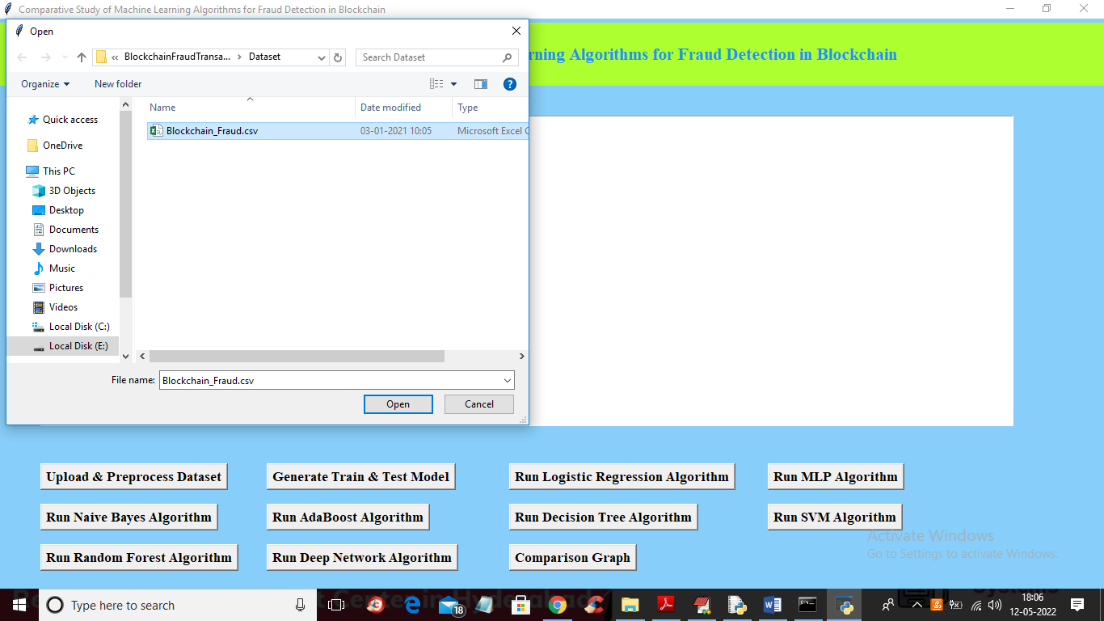
Click on Upload & preprocess dataset

Slide 27
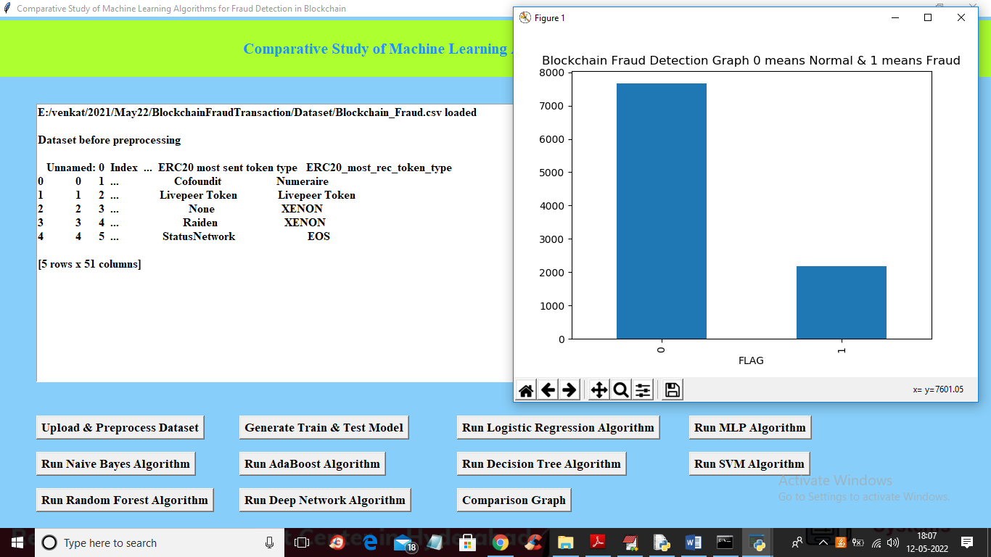
Click on Generate train & test model

Slide 28
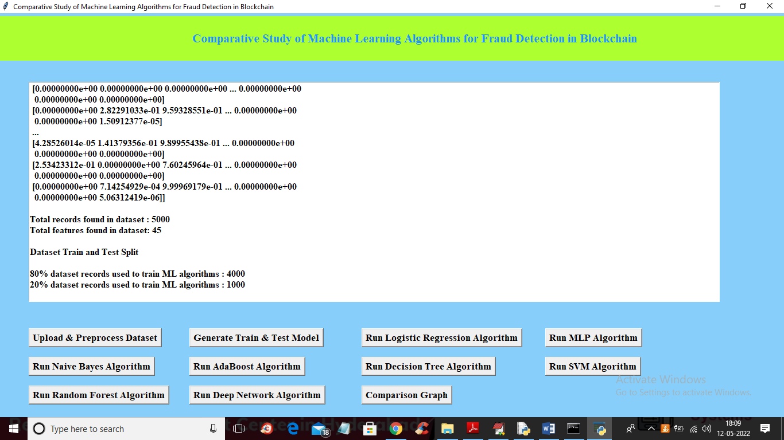
Click on run logistics regression algorithm

Slide 29
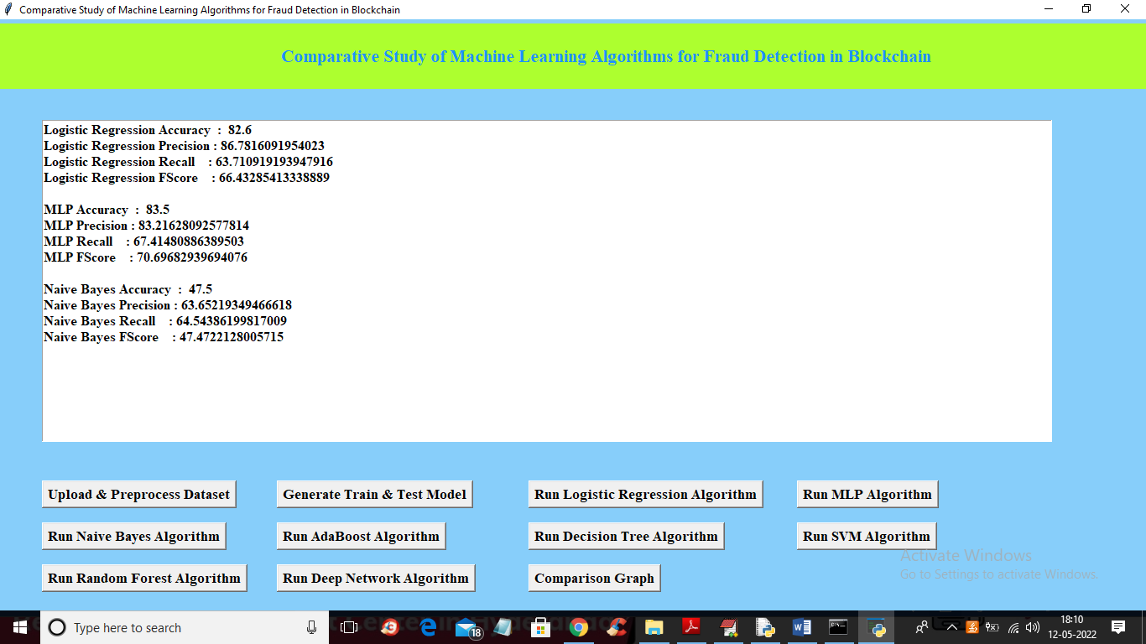
Click on Run MLP algorithm and run naïve Bayes algorithm

Slide 30
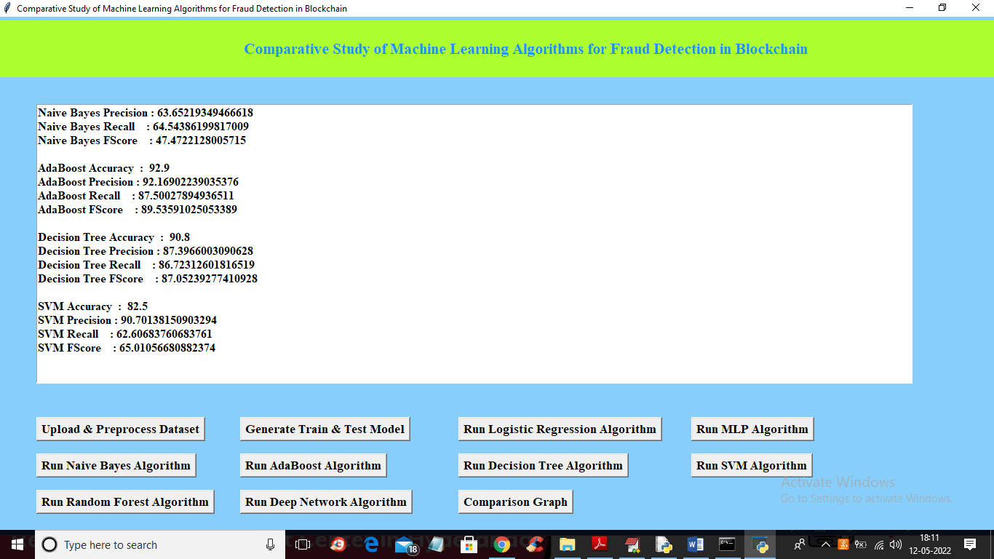
Click on Run Naïve bayes algorithm ,Run AdaBoost Algorithm ,Run Decision Tree Algorithm and Run SVM algorithm

Slide 31
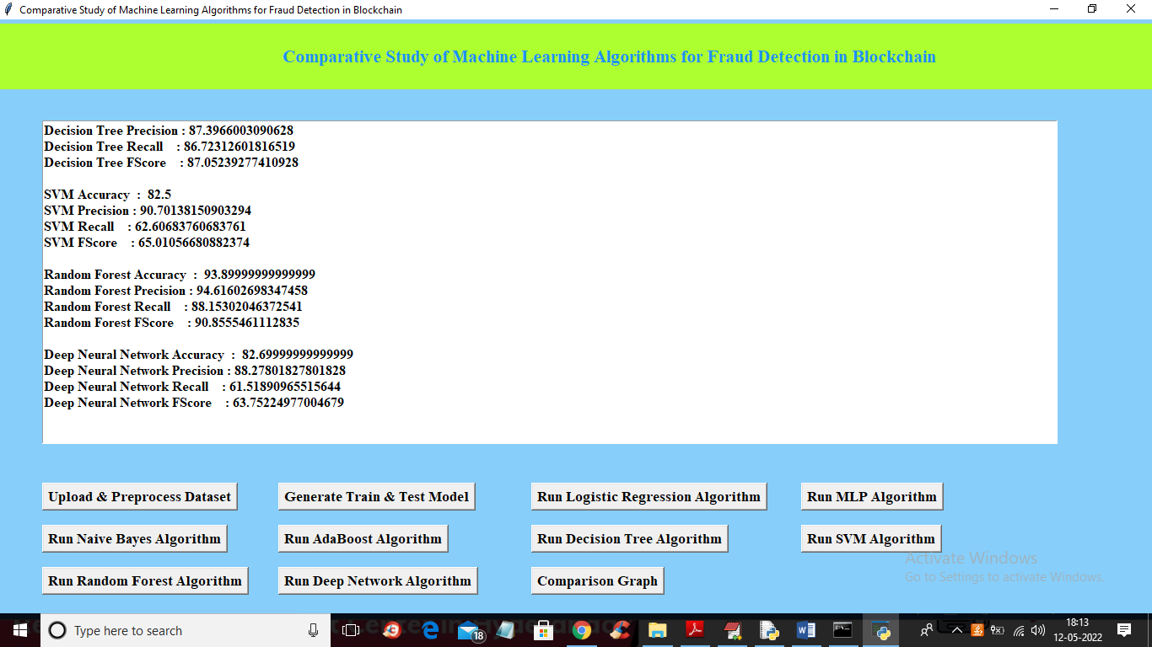
Click on Run Random forest algorithm and Run Deep network algorithm

Slide 32
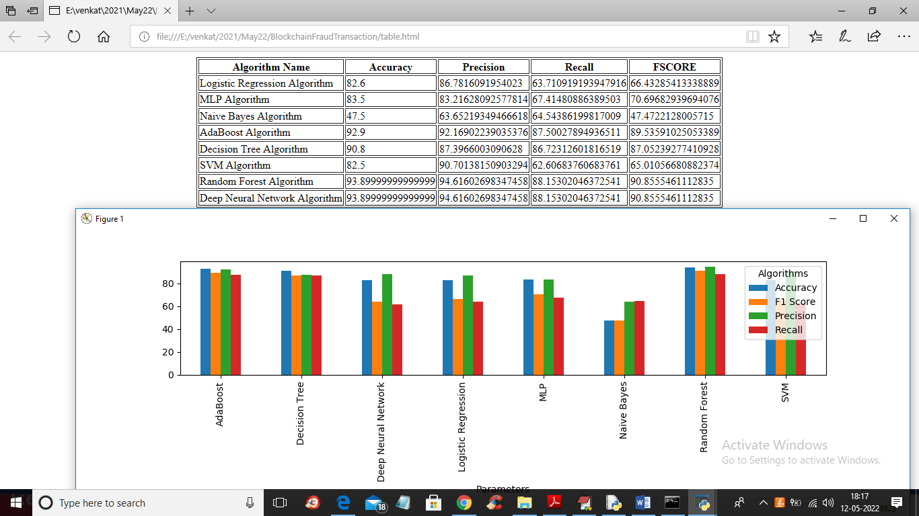
Click on Comparison graph

Slide 33
CONCLUSION :
This method has been proposed for the detection of fraudulent transactions in a blockchain network using machine learning. In this method, various supervised learning approaches like support vector machines, decision trees, logistic regression, were analyzed.
A thorough comparative analysis of all the approaches is performed through accuracy. This work can be extended for the comparative study of unsupervised algorithms like clustering.

Slide 34
Future Scope:
Hybrid Approaches: Combining the strengths of both blockchain and machine learning can lead to powerful fraud detection systems. Future research may focus on developing hybrid models that leverage blockchain for data integrity and security while using advanced machine learning for fraud detection.
Scalability: As the volume of blockchain transactions increases, the scalability of fraud detection systems becomes crucial. Future projects may explore ways to optimize and scale machine learning algorithms for large-scale blockchain networks.
Cross-Industry Applications: The skills and knowledge gained from a comparative study of machine learning algorithms for fraud detection in blockchain can be applied to various industries beyond finance, such as healthcare, supply chain, and more.

Slide 35
References of our study:
Cai, Y., Zhu, D. Fraud detections for online businesses: a perspective from blockchain technology. Financ Innov 2, 20 (2016). https://doi.org/10.1186/s40854-016-0039-4
Hyvarinen, H., Risius, M. & Friis, G. A Blockchain-Based Approach ¨ Towards Overcoming Financial Fraud in Public Sector Services. Bus Inf Syst Eng 59, 441–456 (2017). https://doi.org/10.1007/s12599-017-0502- 4
Xu, J.J. Are blockchains immune to all malicious attacks?. Finance Innov 2, 25 (2016). https://doi.org/10.1186/s40854-016-0046-5
Ostapowicz M., Zbikowski K. (2019) Detecting Fraudulent Accounts on ˙ Blockchain: A Supervised Approach. In: Cheng R., Mamoulis N., Sun Y., Huang X. (eds) Web Information Systems Engineering – WISE 2019. WISE 2020. Lecture Notes in Computer Science, vol 11881. Springer, Cham. https://doi.org/10.1007/978-3-030-34223-4 2
Podgorelec, B., Turkanovic, M. and Karakati ´ c, S., 2020. A Machine ˇ Learning-Based Method for Automated Blockchain Transaction Signing Including Personalized Anomaly Detection. Sensors, 20(1), p.147.

Slide 36
Github link :
https://github.com/207R1A0522/Fruad_Detection_in_Blockchain

Slide 37


